Slide 1
DEPARTMENT OF ADMINISTRATION preserving the past, serving people today, planning for tomorrow
STATE PUBLIC WORKS DIVISION
AGENCY PRESENTATION TO THE BOARD
August 27, 2020
LAURA E. FREED, Director
WARD PATRICK, SPWD Administrator
Kent A. LeFevre, SPWD Deputy Administrator

Slide 2
DEPARTMENT PROJECTS
Department of Administration
Attorney General’s Office Central Plant
Advance Planning: Grant Sawyer Office Building Remodel
Lease Purchase Building Construction
Construction of an Administration Building at the East Sahara Site

Slide 3
DEPARTMENT RANK: 1
Attorney General’s Office,
Central Plant Renovation

Slide 4
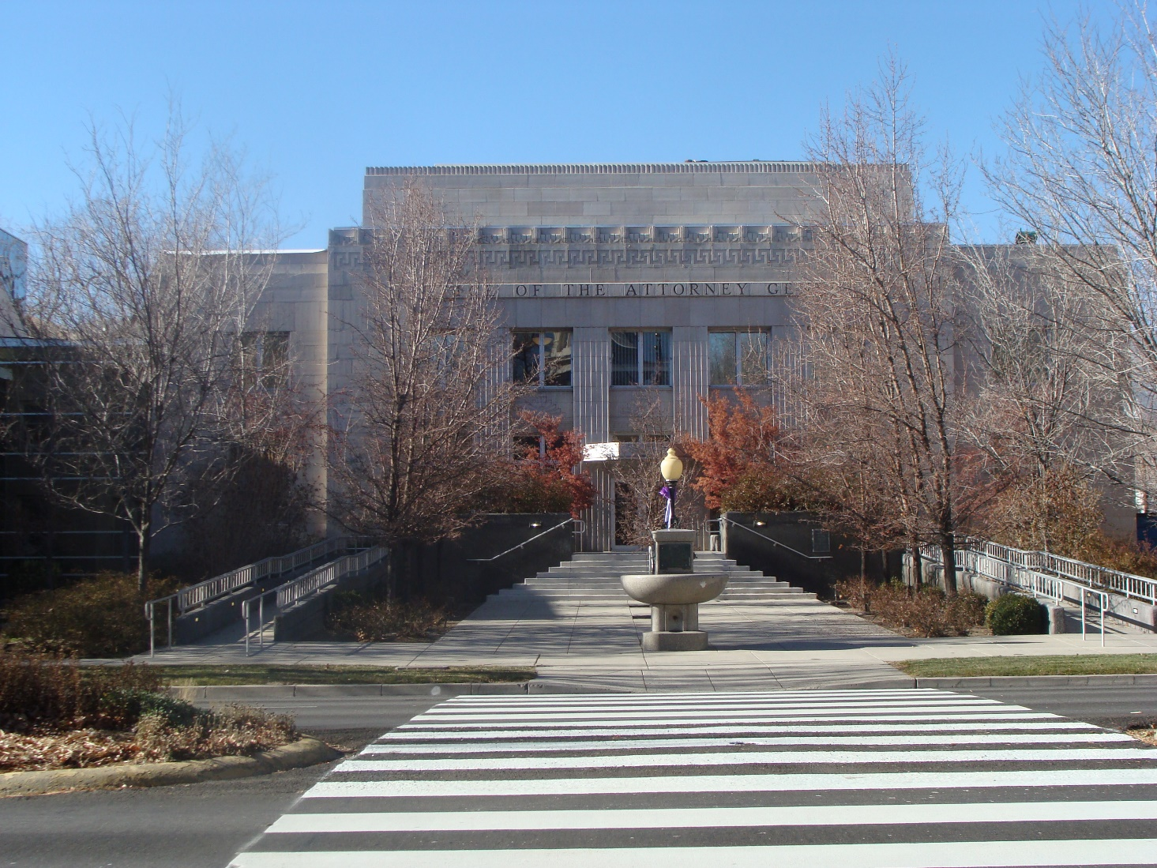
Attorney General’s Office- Exterior Photo

Slide 5
Attorney General’s Office- Project Detail
Budget Detail
  Total Budget: $1,862,215
  Professional Services Total $ 138,578
  Building & Misc. Total $1,723,637
  100% State Funded
Scope
  This project will renovate the existing central plant heating and cooling equipment. This renovation includes: replacement of the chiller, cooling tower, boilers, pumps, piping, and related controls.
  Replacement of the domestic hot water tempering station with an electronic station.
  The boiler and chiller room walls and floors will receive treatments to prevent water penetration into adjoining spaces.
  The design of this project was developed as part of CIP project 19-M30, however the construction budget for this project was swept in the special session with SB1.

Slide 6
DEPARTMENT RANK: 2
Advance Planning:
Grant Sawyer Office Building,
Remodel

Slide 7
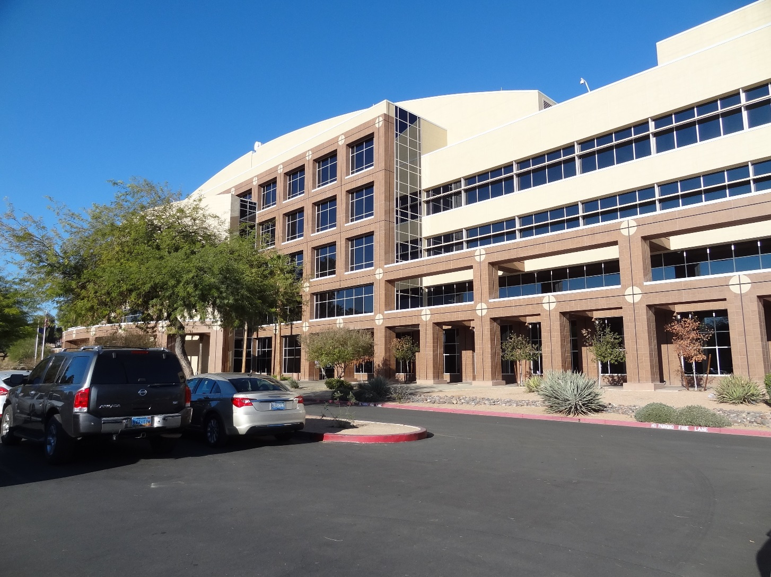
Grant Sawyer Office Building- Exterior Photo

Slide 8
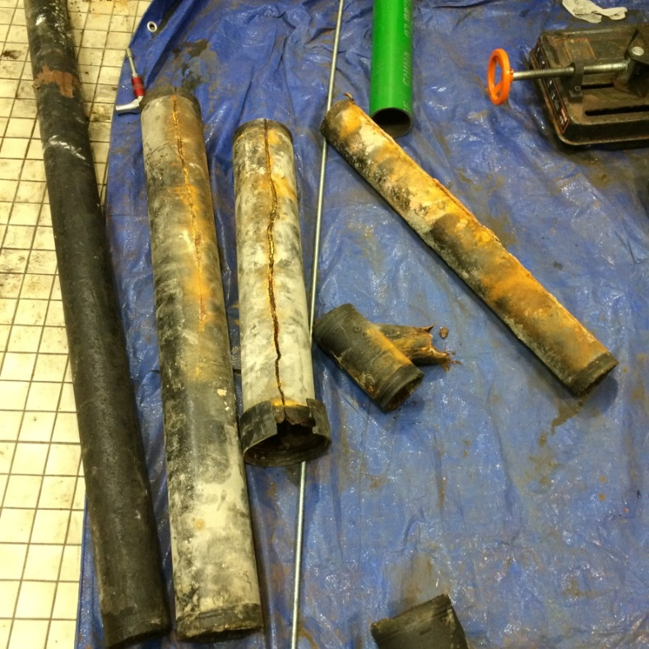
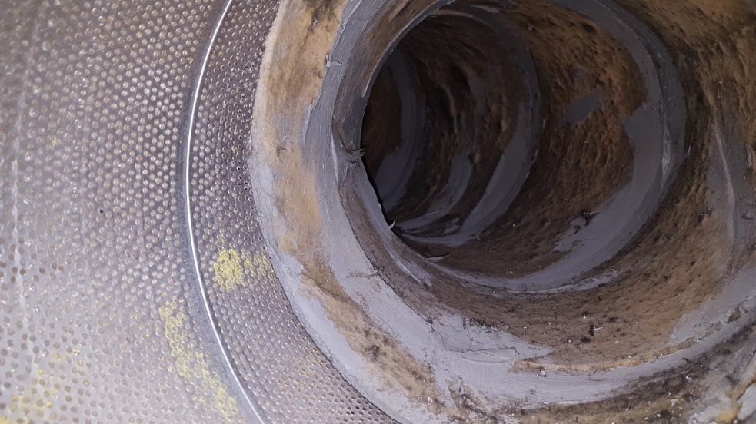
Grant Sawyer Office Building- Photos
Failed mechanical ductwork.
Failed piping under floor slab.

Slide 9
Grant Sawyer Office Building- Project Detail
Budget Detail
  Total Budget: $5,388,617
  Professional Services Total $5,250,465
  Building & Misc. Total $ 138,150
  100% State Funded
Scope
  This project will complete the advance planning of 19-P01.
  The project will provide the design for the replacement of interior partitions, carpet, wallcoverings, interior lighting, HVAC, life safety systems, plumbing, sewer modifications, and the elevators located in the main lobby.
  Design improvements will include changes to the public hearing chambers, atrium infill at levels 3 and 4, an increase to the security of the dignitary parking area and electric vehicle charging stations.

Slide 10
DEPARTMENT RANK: 3
Lease Purchase:
Administration Building,
Kinkead Building Site

Slide 11
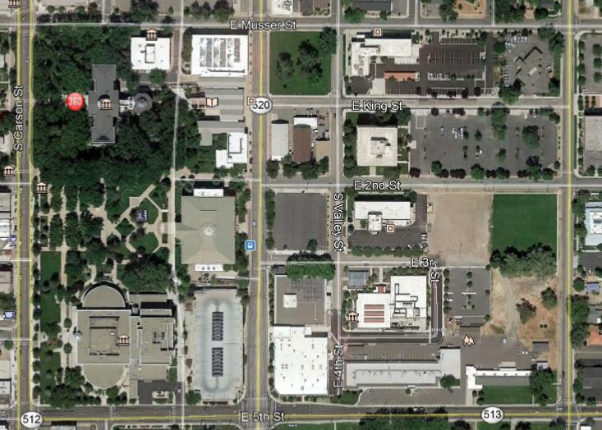
Administration Building- Existing Aerial
NV State Library and Archives
Buildings & Grounds Shop
Blasdel Building
EICON Building
Fleet Services
Capitol Building
Former Location of the Kinkead Building (Demolished 2017)
NV State Supreme Court
Employment, Training and Rehabilitation
Enterprise Information Technology Services
Department of Education
State Mail
State Printing Office
North

Slide 12
Administration Building- Proposed Aerial
NV State Library and Archives
Buildings & Grounds Shop
Blasdel Building
EICON Building
Fleet Services
Capitol Building
Capitol Building
Proposed Lease Purchase Department of Administration Building
NV State Supreme Court
NV State Supreme Court
Employment, Training and Rehabilitation
Legislature Building
Enterprise Information Technology Services
Department of Education
State Mail
State Printing Office
State Printing Office
North
North

Slide 13
Administration Building- Project Detail
Budget Detail
  Total Budget: $92,448,166
  Professional Services Total $ 9,264,268
  Building & Misc. Total $83,183,898
  100% State Funded
Scope
  This project will design and construct a 100,000 sf building in the Capitol Complex for the Department of Administration to house several Agencies including the Director’s Office, Administrative Services, Enterprise IT Services, and Fleet Services amongst others.
  This project also includes the demolition of the Blasdel Building.
  Furnishings, fixtures, and equipment (FF&E) will be deferred to the 2023 CIP.
  The design of this building will accommodate the projected growth for the next ten years.
  This project is proposed to be funded using lease purchase.

Slide 14
DEPARTMENT RANK: 4
Administration Building,
Sahara Complex

Slide 15
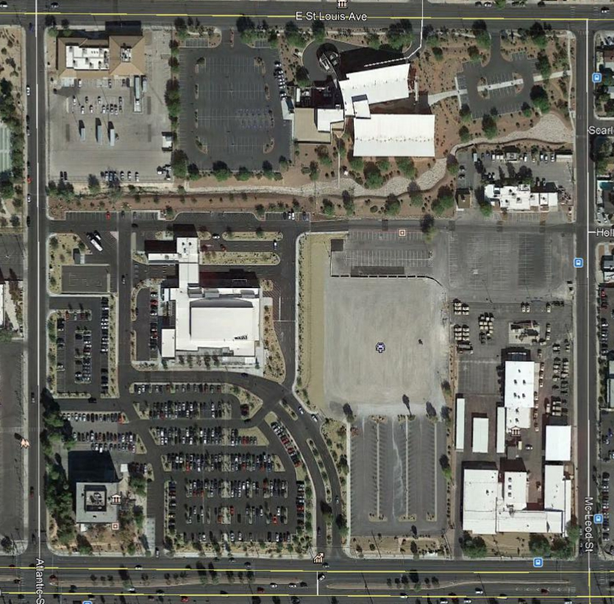
Administration Building- Existing Aerial
Department of Agriculture
McLeod Building
Sahara DMV
North
Bradley Building

Slide 16
Administration Building- Existing Aerial
Department of Agriculture
McLeod Building
Sahara DMV
Proposed Department of Administration Building
Bradley Building
North

Slide 17
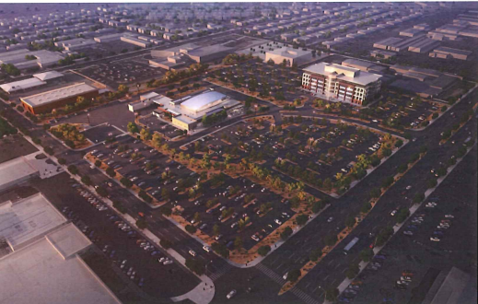
Administration Building- Conceptual Site Plan
Department of Agriculture
Proposed Department of Administration Building
Sahara DMV

Slide 18
Administration Building- Project Detail
Budget Detail
  Total Budget: $107,998,191
  Professional Services Total $ 10,452,853
  Building & Misc. Total $ 97,545,338
  100% State Funded
Scope
  This project will design and construct a building at the East Sahara Site for Buildings and Grounds to rent to state agencies.
  Professional services and soft costs are planned to be funded with State funding. The remaining costs will be paid with revenue bonds.
  The source of funding for the revenue bonds is the rent collected by the Buildings and Grounds section of the State Public Works Division. This rent is to be distributed across all building spaces for which Buildings and Grounds charges rent on.

